Slide 1
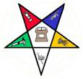
HELPFUL
GUIDE
ON
WHAT
TO
WEAR
Traveling Abroad:
Check-in with your doctor and insurance carrier. Bring Prescriptions
Leave a copy of your passport with relative. Bring copies of your passport.
Leave information with Relative: Destination, Hotel, traveling with.
Look up the monetary conversion before you go. Always have local cash.
Call your bank or credit card provider. Make sure your credit card will work in the country you’re visiting. Notify bank of your destination.
Bring a charger adapter. Activate your phone’s global capabilities.
Pack an extra set of clothes in your carry-on bag.
Disclaimer: This Booklet is offered to you ONLY as a guide on what to wear.
Some statements may have changed due to unwritten protocol.
Created by GWM Karen Williams
Call 206-854-4987

Slide 2
EASTERN STAR
Meetings – White Dress/Suit, White stockings, White
Gloves, White jewelry, White shoes, Sash
Grand Session – 1st day: Long White Dress/Suit, White
stockings, White Gloves, White jewelry, White shoes, Sash. Grand Officers Long White every day
Banquets – Formal & Semi Formal. Grand Officers: GWM’s Color preferred but not mandatory
Workshops –Business Casual, Pride Suits.
Esther Day- Long White Dress/Suit, White gloves,
stockings, White jewelry, White shoes, Sash. Flower on left side. Sash
Pacific Rim Conference- Business Casual, Pant Suits permitted only if Host GWM allows
Visitation – Long White Dress/Suit, White stockings, White Gloves, White jewelry, White shoes, Sash
Luncheon - Dressy/ Grand Officers: GWM’s Color preferred but not mandatory
Funerals - Short White Dress/Suit, White stockings, White Gloves, White jewelry, White shoes. (Regalia by order of GWM). Grand Chapter Officers- Long White
All White
Under garments
NO PANTS AT BANQUETS OR BALLS
NO BEIGE OR
OFF WHITE!!!
NO PLUNGING NECKLINES OR SLITS ABOVE THE KNEE
No hats at meetings
Remember – “If you have to tell someone you are a Lady”, then…….. ………
Let your attire speak for itself!!!

Slide 3
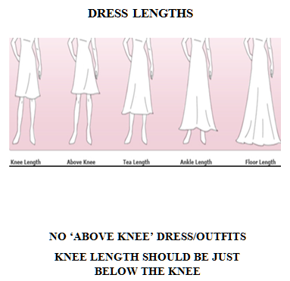
Someone may ask no matter who you are
What is the Order of the Eastern Star?
If you’ve not been a member for a while or so,
There are just a few facts you may want to know.
We belong to an Order, the largest of its kind.
A fraternity in which men and women you will find.
Its members are found in every corner of the globe,
And each is part of the great Masonic fold.
Our purpose is to inspire good; it’s that simple and plain;
The tenets of truth, charity, loyalty and kindness we train.
Charitable and benevolent projects are the things we do
To help friends in need and to see their trouble through.
Our principles are based on Biblical days
But in no way conflict with our religious ways.
We have lots of fun, too, as everyone should,
Meeting and traveling and working for good.
And because of our goals, we develop a bond
For each member, one to another, we become very fond.
This is an Order like no other you will find,
A chance to do good for your fellow mankind.
- Author Unknown –
Knee Above Tea Ankle Floor
Length Length Length Length Length

Slide 4
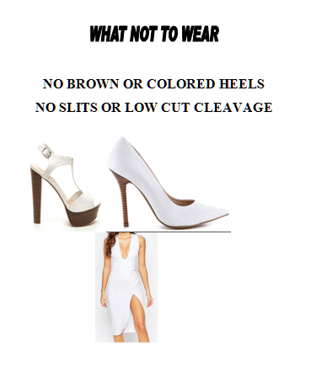
Strapless, Spaghetti Straps,
Straps & Sleeveless is
Acceptable
with a
Cover Up.

